Slide 1




Bookify
Redefining Hospitality Management with Intelligent Solutions.
DEPI Graduation Project
Team: InnovateX Team
30/11/2025
1

Slide 2

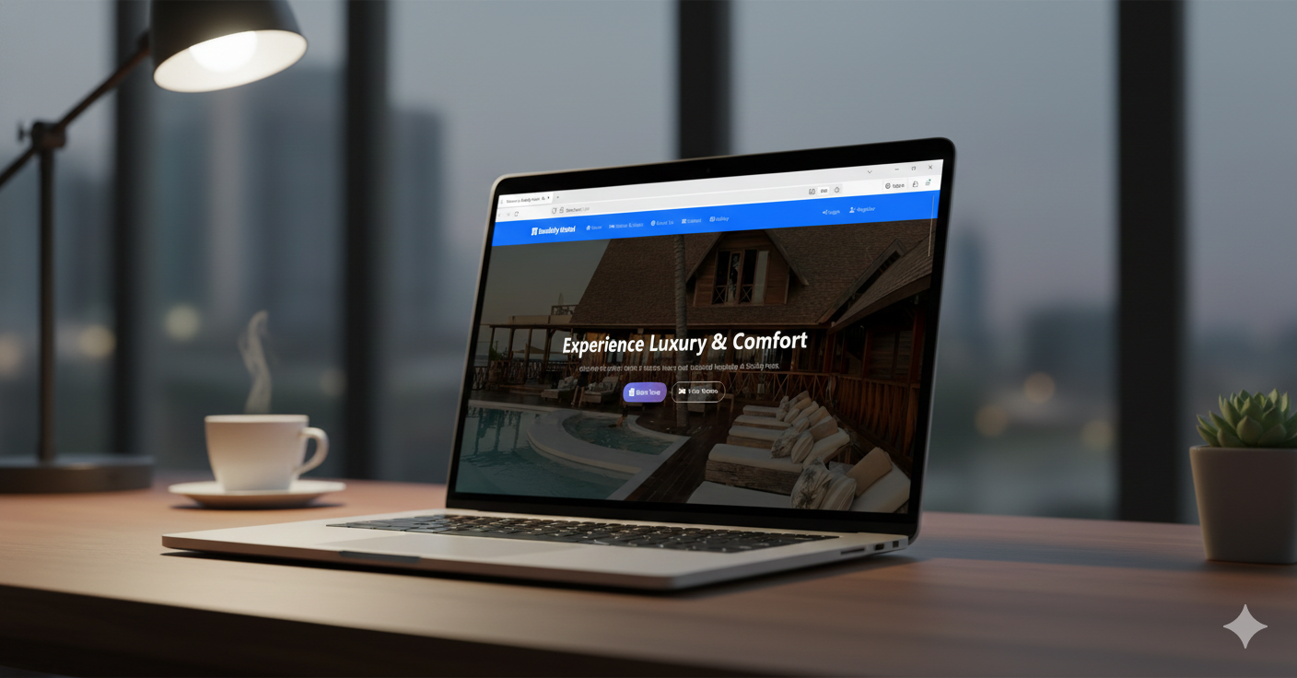
The Hospitality Gap – Problem & Solution
⚠ PROBLEM:
- Double Booking Conflicts
- Lack of Real-time Financial Insights
- Poor Mobile Experience
💡SOLUTION (Bookify):
A full-stack scalable platform delivering seamless hotel management, live data analytics, and secure payments.
30/11/2025
2

Slide 3
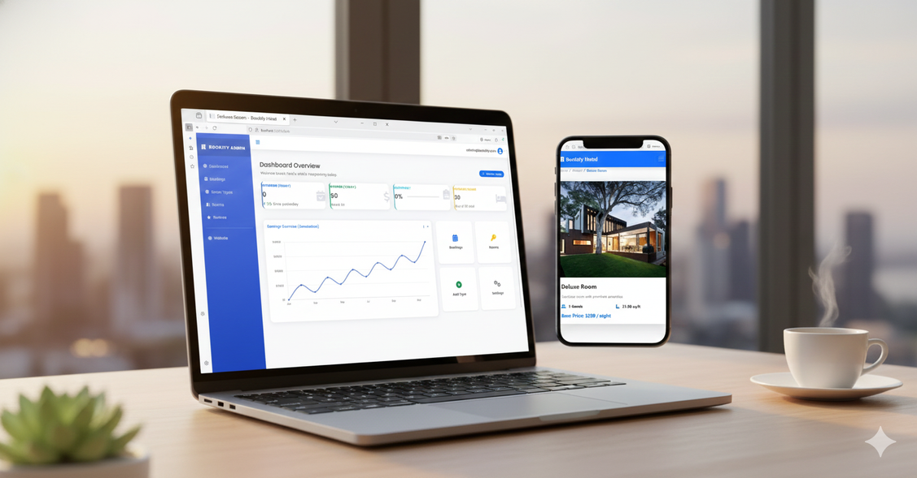

User Journey & UI Concept
🔹 Homepage → Filtering Rooms
🔹 Booking Confirmation → Payment
🔹 Instant Admin Dashboard Updates
30/11/25
3

Slide 4

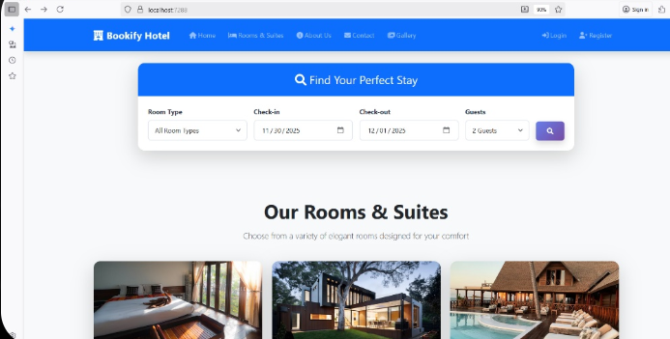
End Users & Key Features
👤 End Users:
- Admin
- Hotel Manager
- Guest
✨ Core Features:
1. Real-time Analytics Dashboard
2. Dynamic Room Status System
3. Secure Payments (PayPal/Visa)
4. Role-Based Access Control (RBAC)
10/14/24
4

Slide 5
Database Architecture
SQL Server
🔗 Key Relationships:
- Users ↔ Bookings
- Rooms ↔ Status
- Payments ↔ Refund Tracking
10/14/24
5

Slide 6




Technical Stack
Backend: ASP.NET Core 8 MVC (C#)
Database: SQL Server + EF Core
Frontend: Bootstrap 5 (Responsive)
Architecture: Clean Architecture + SOLID Principles
10/14/24
6

Slide 7




Live Application & Testing
- Unit Testing
- Integration Testing
- User Feedback
- Beta Version Available
10/14/24
7

Slide 8
Project Team & Roles
👨‍💻 Backend Developers:
- Abdelrahman Mohamed Ahmed Abaza
-Ahmed Ashraf Mosed Abdelaziz
- Mohammed Emad Mohamed Elghonimy
🎨 Frontend Developers:
- Habiba Mohamed Abdalrhman Mohamed
- Kareem Helmy Mohamed Ibrahim
Team Name: InnovateX Team
11/30/2025
9

Slide 9
Thank You!
Any Questions ?
10

